Slide 1


Chapter 25
CREDIT MANAGEMENT
Copyright © 2015 by McGraw Hill Education (India) Private Limited
© Centre for Financial Management , Bangalore

Slide 2
Meaning of receivables management
Features of receivables management
Objectives of receivables management
Important dimensions of credit policy of a firm
Obstacles for a standard policy of receivables management
How to achieve optimum receivables standard

Slide 3
Features of Receivable Management:
Sundry Debtors and Bills Receivable
Credit Sale
Receivables
Credit period
Sale payment cycle
Investment in Accounts Receivable
Risk
Credit policy
Costs like collection cost, capital cost, delinquency cost, default cost.
Cost – benefit trade off

Slide 4
Objectives of Receivables Management:
Creating, presenting and collecting accounts receivables.
In order to establish and communicate the credit policies.
For evaluation of customers and setting credit limits.
In order to ensure prompt and accurate billing.
To maintain up-to –date record of accounts receivables.
To initiate collection procedures on overdue accounts.

Slide 5
CREDIT POLICY VARIABLES
The important dimensions of a firm’s credit policy are:
Credit standards
Credit period
Cash discount
Collection effort
© Centre for Financial Management , Bangalore

Slide 6
CREDIT STANDARDS
Liberal Stringent
Sales Higher Lower
Bad debt loss Higher Lower
Investment Larger Smaller
in receivables
Collection costs Higher Lower
© Centre for Financial Management , Bangalore

Slide 7
CREDIT PERIOD
Longer Shorter
Sales Higher Lower
Investment in Larger Smaller
receivables
Bad debts Higher Lower
© Centre for Financial Management , Bangalore

Slide 8
Exercise
Shri Krishna Ltd has current sales of ₹ 20,00,000. The firm is planning to introduce a cash discount policy of 2/10, net 30. As a result, the firm expects the average collection period to go down by 10 days and 75% of the customers opt for the cash discount facility. If the firm's required return on investment in receivable is 12% should it introduce the new discount policy? (Assume 365 days in a year)

Slide 9
Soln.
Account receivable before cash discount= 2000000*30/365=164384
Account receivable after cash discount= 2000000*20/365=109589
Decrease in accounts receivable investment =164384-109589=54795
Return on decreased investment in receivable =12%*54795=6576
Discount at 2% used by 75% of sales=2000000*0.75*0.02= 30000
As the loss due to new policy is ₹ 30000 is more than the return on receivable investment is ₹ 6576, the new policy should not be accepted.

Slide 10
Q. 2
Cool Ltd is making sales of ₹ 1600000 and it extends a credit of 90 days to its customers. However in order to overcome the financial difficulties, it is considering to change the credit policy. The proposed terms of credit and expected sales are given below
The Cool Ltd has a variable cost of 70% and fixed cost of ₹ 150000.The cost of capital is 10%.Evaluate different proposed policies and which policy should be adopted?( Assume 365 days in a year)
Policy | Terms | Sales
A | 45 days | 1536000
B | 60 days | 1560000

Slide 11
Soln.
Evaluation of Credit Period:
Evaluation of Credit Period:
Particulars | Present (90 days) | 45 days | 60 days
Sales (A) | 1600000 | 1536000 | 1560000
Variable Cost (70%) | 1120000 | 1075200 | 1092000
Fixed Cost | 150000 | 150000 | 150000
Total Cost (B) | 1270000 | 1225200 | 1242000
Profit (A-B) | 330000 | 310800 | 318000
Average Receivable(at cost)
(Total cost/365)*credit period | 313151 | 151052 | 204164
Cost of receivable @ 10% | 31315 | 15105 | 20416
Net profit | 298685 | 295695 | 297584

Slide 12
Soln.
It may be observed that the profit of the firm is going to reduce from the present level of ₹ 298685 to ₹ 295695 in case the policy of 45 days credit period is adopted and further to 297584 if 60 days credit period is adopted. Hence, it is beneficial for the company to give 90 days credit to its customers.

Slide 13
Q. 3
XYZ Ltd has credit sales amounting to `32,00,000. The sale price per unit is `40, the variable cost is `25 per unit while the average cost per unit is `32. The average age of accounts receivable of the firm is 72 days.
The firm is considering to tighten the credit standards. It will result in a fall in sales to `28,00,000, and the average age of accounts receivable to 45 days.
Assume 20 per cent rate of return. Is the proposal under consideration feasible?

Slide 14
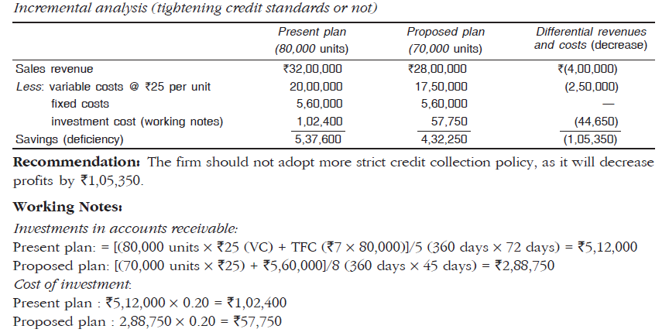
Soln. Q. 3

